Slide 1

How to Reflect efficiently
Prepared by: Jasmine Walker | PP.PAT.10 | Approved by: Rachel Nicholas
Reflections- What is the point?

Slide 2
What we are covering
Prepared by: Jasmine Walker | PP.PAT.10 | Approved by: Rachel Nicholas
What is reflective learning?
Why do we participate in reflections?
  How does this benefit us
  How does this benefit the service users
Example reflections
Summary

Slide 3

What is reflective learning?
Prepared by: Jasmine Walker | PP.PAT.10 | Approved by: Rachel Nicholas
Reflective learning is the process of analysing an event or piece of learning that you have undertaken, looking at what went well, what could be improved upon and how this can be used to impact your provision of service in the future.

Slide 4
Why do we participate in reflections?
Prepared by: Jasmine Walker | PP.PAT.10 | Approved by: Rachel Nicholas
By reflecting on our practise it allows us to look at situations or learning in a way that we may not have done originally
It re-affirms the learning that we have undertaken
It allows us to look at how this can be applied to our everyday practise.
If you have attended a day long course it is easy to only focus on the points that you found particularly interesting. However by looking back and reflecting on this you could discover that a different section of the talk can impact the way that you should be working.

Slide 5
How do we reflect?
Prepared by: Jasmine Walker | PP.PAT.10 | Approved by: Rachel Nicholas
The process of reflection is not a complex one.
Focus on the task you want to reflect on
  How does performing/not performing the task/ performing the task ineffectively impact the service user?
  Why have you completed this task?
  What have you learnt from this task?
  How have/can/will you apply this learning in you work?
  Are there any procedures that could be altered to align to/improve from this learning?

Slide 6
How do we reflect?
Prepared by: Jasmine Walker | PP.PAT.10 | Approved by: Rachel Nicholas
Each trust will have their own template for completing reflections, these can be relatively simple. Or can have lots of prompts on them to aid with your reflective practice.
The IBMS CPD website also has an online reflective worksheet, which it uses when submitting evidence for the CPD diplomas. The current format has four sections to complete. But as the new CPD system is coming in July 2022 I am not going to go through this.

Slide 7
Examples
Prepared by: Jasmine Walker | PP.PAT.10 | Approved by: Rachel Nicholas
I am now going to go through several examples of reflective practice, and discuss which ones show good reflective practice and which could be improved upon.
There are 4 examples that I am going to discuss, each with their own merits.

Slide 8
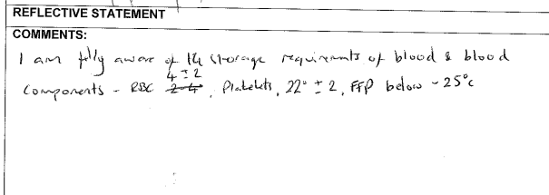
Example 1:
Prepared by: Jasmine Walker | PP.PAT.10 | Approved by: Rachel Nicholas
This is NOT a reflective piece of work!
This person has just stated that they “know” how to do something, they haven’t:
Mentioned why they need to do this
What impact this has if it isn’t done in this matter
How this competency will impact their behaviour

Slide 9
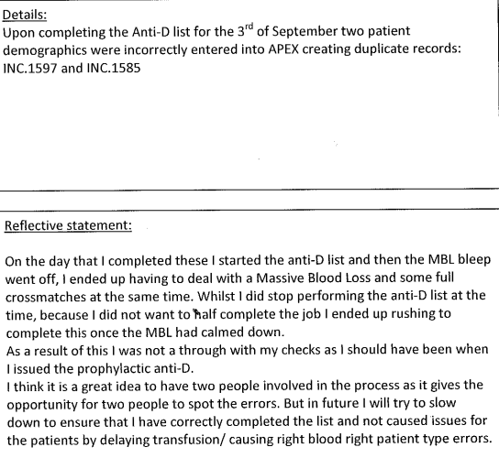
Example 2:
Prepared by: Jasmine Walker | PP.PAT.10 | Approved by: Rachel Nicholas
This is reflective!
The person who has completed this has:
Explained what happened
Explained how their actions could impact the service user
Involved a positive change to the procedure to prevent further errors
And reflected on how they will alter their practise.

Slide 10
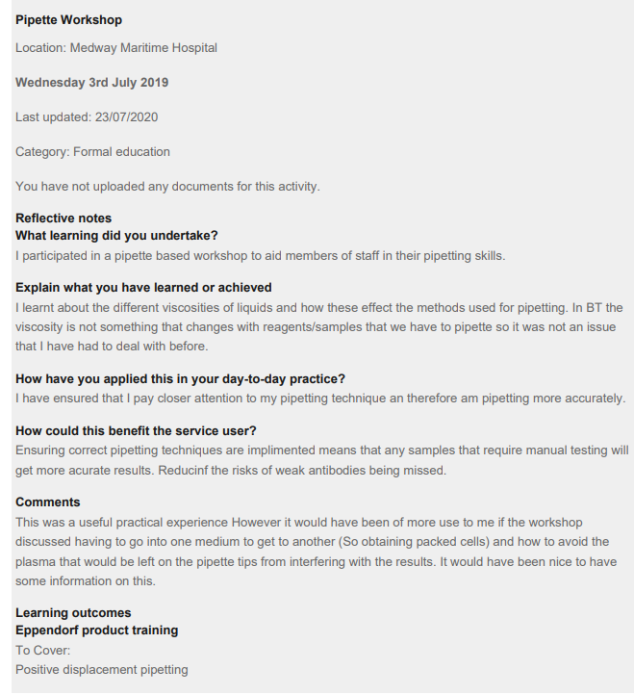
Example 3:
Prepared by: Jasmine Walker | PP.PAT.10 | Approved by: Rachel Nicholas
This reflection uses the IBMS’ format for reflective practise. This format is used to help you to think in a reflective manner and is what our internal form is based off of.
This reflection is not very in depth but because of the use of this format it still hits all of the requirements of a reflective piece of work!

Slide 11
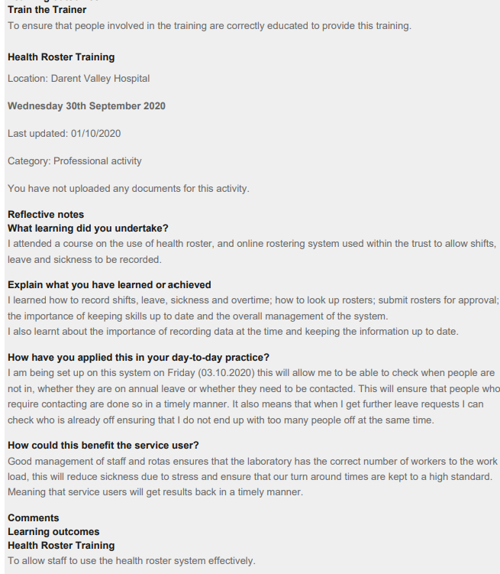
Example 4:
Prepared by: Jasmine Walker | PP.PAT.10 | Approved by: Rachel Nicholas
Example 4:
Reflection of participation E-roster training.
This piece of work has more information than the rest of the reflective practise and is a good example of a longer more in-depth piece of work.

Slide 12
Summary
Prepared by: Jasmine Walker | PP.PAT.10 | Approved by: Rachel Nicholas
Hopefully you can see what makes a good reflective piece of writing.
Any questions?

